Slide 1
5.2 system bus

Slide 2
Objectives
show understanding of how data are transferred between various components of the computer system using the address bus(地址总线), data bus (数据总线) and control bus(控制总线)
show understanding of how the bus width(总线宽度) and clock speed(时钟速度) are factors that contribute(贡献) to the performance of the computer system
show understanding of the need for ports(端口), for example Universal Serial /ˈsɪriəl/ Bus (USB), to provide the connection to peripheral /pəˈrɪfərəl/ devices(外部设备)

Slide 3
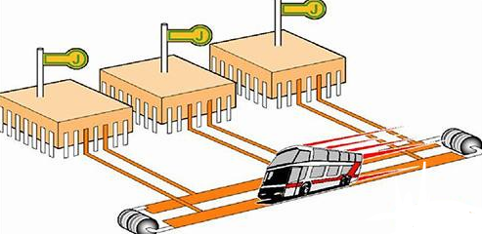
System Bus
The information transmitted on the system bus includes data information, address information, and control information.
Therefore, the system bus includes buses having three different functions: data bus, address bus, and control bus.

Slide 4
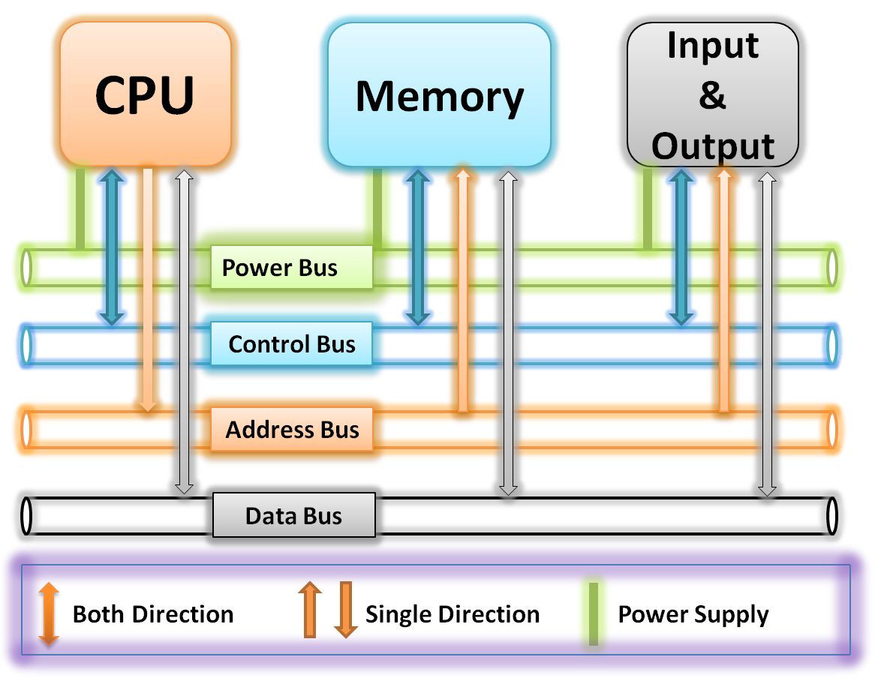
System Bus

Slide 5
Introduction
Data Bus
Data bus is used to transfer data between components of the computer system. It is a bidirectional 双向的 transmission bus. The data bus determines the bit width of the CPU, that is, how many binary numbers can be processed at one time.
Address Bus
The address bus is mainly used to indicate the address of the destination data in the main memory unit or the address of the I/O device. It is a one-way transmission bus.
Control Bus
The control bus is a transmission line for issuing(发出) various control signals and sequence signals.

Slide 6

Data Bus
Data Bus
  The data bus is used to transfer data information.
  The data bus can transfer data from the CPU to the memory or IO device, or from other components to the CPU.
  The meaning of data is generalized.
  It can be real data, it can also command code or status information, and sometimes even a control information. Therefore, the data bus does not always transmit 'data' in the traditional sense.

Slide 7
Address Bus
Address Bus
  The CPU accesses the memory unit by address.
  The address is transmitted via the address bus.
  In general, if n different types of information can be transmitted on the address bus, the CPU can determine the location of n memory locations.
  Suppose a CPU has 7 wires to form an address bus. At each moment, there are only two states that a wire can represent. In binary representation, it is 1 or 0, then 7 wires can transmit 7-bit binary data, corresponding to 2^7 states. If each memory unit can store 2 bits of data, what is the maximum effective memory of the computer?

Slide 8
Why is there a path from the CPU to the I/O devices in the address bus?

Slide 9
Control Bus
Control Bus
  The control bus is used to transmit control signals and sequence signals.
  Among the control signals, there are signals sent from processors to the memory and IO devices, such as read/write signals and interrupt response signals.
  The control signal is also sent to the CPU by other components, such as an interrupt 中断 request signal, a reset signal, a bus request signal, and a device ready signal.

Slide 10
What information is passed from the CPU to the IO device in the control bus?

Slide 11
Why is there a path from the I/O devices or the memory to the CPU in the control bus?
Why is there a path from the CPU to the I/O devices in the address bus?

Slide 12
How to Increasing Performance
If we want to increase the performance of our computer, we can try several things:
Increasing the clock speed
Increasing bus widths
Adjusting word length

Slide 13
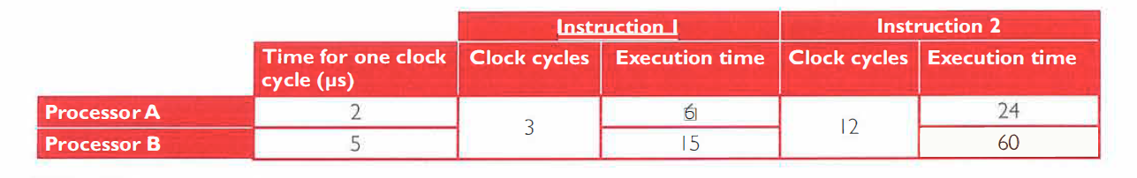
Clock Speed
Clock speed
The number of executions that are performed by the CPU per second
Clock speed is measured in Hertz, which means 'per second'.
A computer of speed 3.4 GHz means it might be capable of performing 3,400,000,000 executions per second!

Slide 14
Clock Speed
What does a processor clock do？
Synchronises(同步) the operation of the processor

Slide 15
Bus Size
Bus Size - The number of bits of information a bus can carry at one time (the number of wires making up (组成) a bus)

Slide 16
Word Size
Word size - The number of bits that the CPU can process in parallel at one time.
  The word length is always an integer multiple of 8.
  Generally, the word length of a PC is 32 bits and 64 bits.

Slide 17
Ports
I/O ports is a complementary （补充性） method of performing input/output between the CPU and peripheral devices(外设) in a computer.
This allows I/O devices to be connected to the CPU without having to have specialist hardware for each one.
Think about the USB port on your computer, you can connect Keyboards, Mice, Game pads, Cameras, Phones, etc. and they all connect using the same port.

Slide 18
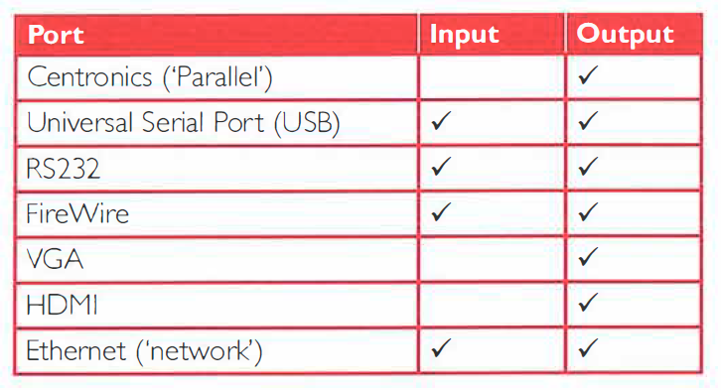
Ports

Slide 19
Universal Serial Bus(USB)
通用串行总线
Devices automatically detected and configured when first attached
It is nearly impossible to wrongly connect a device
USB has become an industrial standard
Supported by many operating systems
USB 3.0 can send information while receiving information(full duplex data transfer，全双工数据传输)
Compatibility 兼容性 among different versions is good

Slide 20
3
1. Clock
2. Processor
3. Main memory
4. keyboard controller
5. VDU controller
6. Disk controller
7. Data bus (or Control bus)
8. Control bus (or Data bus)
9. Address bus
10. Keyboard
11. Monitor
12. Secondary storage

Slide 21
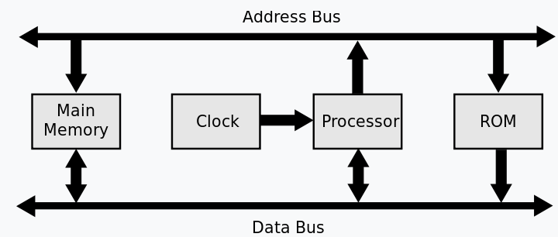
4

Slide 22
5(a)
data bus width
• the width of the data bus determines the number of bits that can be simultaneously transferred
• increasing the width of the data bus increases the number of bits/amount of data that can be moved at one time (or equivalent)
• …hence improving processing speed as fewer transfers are needed
• By example: e.g. double the width of the data bus moves 2x data per clock pulse
clock speed
• determines the number of cycles the CPU can execute per second
• increasing clock speed increases the number of operations/number of fetch-execute cycles that can be carried out per unit of time
• ...however, there is a limit on clock speed because the heat generated by higher clock speeds cannot be removed fast enough

Slide 23
5(b)
devices automatically detected and configured when first attached/plug and play
it is nearly impossible to wrongly connect a device
USB has become an industrial standard
supported by many operating systems
USB 3.0 allows full duplex data transfer
later versions are backwards compatible with earlier USB systems
allows power to be drawn to charge portable devices

